Slide 1

Functional Programming and Haskell
CPSC 229-03 / Lecture 2

Slide 2
Syntax and Language Review

Slide 3
Types
At its core, Haskell is about manipulating values with functions.
Every value has a type, which describes the value and what functions can work with them.
Examples:
True :: Bool
1 :: Int
1 :: Double
“hello” :: String -- or, [Char]
[1,2,3] :: [Double]
‘a’ :: Char
(‘a’, True) :: (Char, Bool)
take :: Int -> [a] -> [a]

Slide 4
Definitions, not assignments!
“Variables” in Haskell are not mutable – they don’t change over the course of a program’s execution.
When we say x = 3, it’s not an assignment, like in other languages. It’s a definition.
An assignment is an imperative action that changes a reference in memory at a specific point in time in a sequence of actions.
A definition is “forever”. It doesn’t relate to any sequence of actions, because it’s not an action.

Slide 5
Functions
Functions are also values, and have types!
A function of type a -> b takes an a and returns a b.
A function of type a -> b -> c takes an a, a b, and returns a c.
An a -> b -> c is actually a “partially appliable function”, because it’s really an a -> (b -> c)
Should take be Int -> [a] -> [a], or (Int, [a]) -> [a]?
It’s a style choice!
In most languages, including C, Java, Python, OCaml, etc;, the dominant cultural attitude is to provide multi-argument functions as (a, b) -> c
In Haskell, the overwhelming cultural attitude is to provide multi-argument functions as an a -> (b -> c).

Slide 6
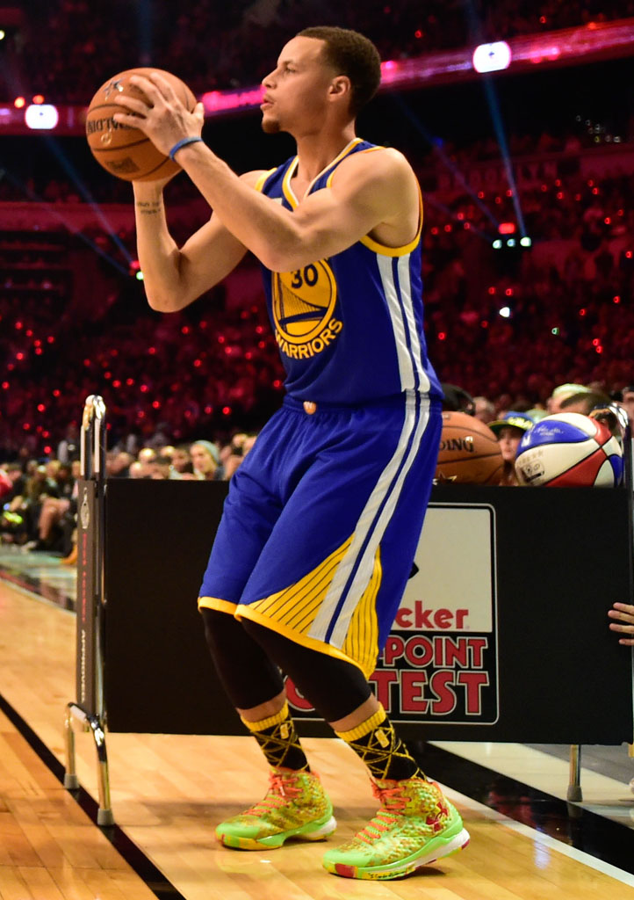
Currying
Is any (a, b) -> c equivalent to an a -> (b -> c)?
Can we always turn plus :: (Int, Int) -> Int into plus :: Int -> (Int -> Int)?
Yes! The process of conversion is called currying.
Which version to offer is a stylistic choice, but the latter gives partial application for free.
solecollector.com

Slide 7
Operators (just syntax)
“Operators” in Haskell are normal user-definable functions with symbols for names.
They may be used in infix form: a + b
Or also in prefix form, as you would use a normal function: (+) a b
Operator associativity and fixity can be user-defined. But function application always binds tighter than any operators:
sin x ^ 2 is parsed as (sin x) ^ 2, not sin (x ^ 2)
Operators can be partially applied, too! Called “sections”.
(2 +) and (+ 2) are partially applied +’s
Normal functions can be used as operators, syntactically, with backticks:
take 3 [1,2,3,4,5] is the same as 3 `take` [1,2,3,4,5]

Slide 8
Typeclasses
Typeclasses act like interfaces in Java, C#, etc. If a type is an instance of a typeclass, it has to implement the methods of the typeclass.
max :: Ord a => a -> a -> a is a function a -> a -> a, as long as a is an instance of the Ord typeclass.
To see what methods are in a typeclass, look at documentation, or :i on ghci.
Typeclasses can be user-defined, and every type must provide its own implementations of its methods.

Slide 9
Pattern Matching
More complicated functions can be declared with pattern matching.
You can pattern match on values and on “shapes”:
fib :: Int -> Int fib 1 = 1 fib 2 = 1 fib n = fib (n-1) + fib (n-2)
fst :: (a, b) -> a fst (x, _) = x
take :: Int -> [a] -> [a] take 0 _ = [] take n (x:xs) = x : take (n – 1) xs
Patterns are “tried out” from top to bottom.
Underscore _ acts as a wildcard where we don’t care about the value.

Slide 10
Lists
Lists are constructed with (:) and []
(:) adds a new item to the front of a given list:
1 : [2,3] => [1,2,3]
[] is the empty list, at the “end”.
[1,2,3] is syntactic sugar for 1 : 2 : 3 : []
When pattern matching on lists, (:) and [] are the “shapes”.

Slide 11
Conceptual Review

Slide 12
Evaluation through Substitution, Referential Transparency, and Purity
Evaluation works by substituting values!
If stringTwice str = str ++ str, we can literally just replace anywhere we see stringTwice “hello” with “hello” ++ “hello”.
This is only possible in Haskell because no values or functions can ever execute any IO. In C, we can’t say that stringTwice(getStdIn) is the same as strconcat(getStdIn, getStdIn). That would read from stdin twice!
This assurance is known as referential transparency. We are free to substitute any function call by its body/definition.
It’s also required that any value will be the same no matter when it’s evaluated, and that there is no hidden state. This means that all values and functions are pure.

Slide 13
Replacing Iteration with Recursion
Instead of control flow with iteration and mutating values, we can use recursion instead! Recursion can in general replace any iteration.
Definitions in general look cleaner and more “declarative”. State how things “are”, not what steps to perform to calculate things.

Slide 14
Recursion is the GOTO of functional programming
Recursion is powerful, but sometimes too powerful.
label START; blah blah; if (condition) then goto START;
while (condition) { blah blah; }
Extremely easy to create bugs!
Can easily create unreadable code!
Code becomes difficult to maintain or improve!
There must be a better way!
GOTO : for loops :: recursion : ??

